Slide 1
BÁO CÁO ĐỀ TÀI NGHIÊN CỨU
Tái tạo đối tượng 3D từ đám mây điểm 3D
(Sử dụng thư việc PCL)
Sinh viên thực hiện:
- Dương Thị An - 20120240
- Phan Đình Anh Quân - 20120635
- Phạm Gia Thông - 20120201
HCMUS UNIVERSITY OF SCIENCE

Slide 2
CONTENT
Motivation
Problem Statement
Introduce to PCL
Marching Cube

Slide 3
MOTIVATION

Slide 4
Motivation
Interesting general scientific problem
Creating, recognizing and analyzing objects from the physical world
Reconstructing objects from the physical word to the digital representation

Slide 5
Motivation
Have a wide variety of applications:
- Virtual reality
- Medical imaging
- Archeological exhibitions
- SLAM
- Urban planning
- …

Slide 6
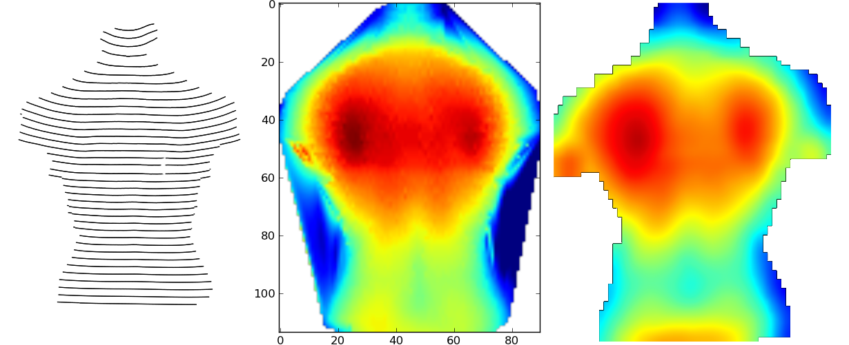
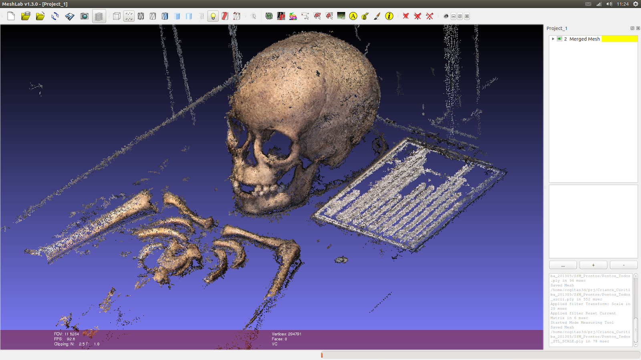
Simulation of human body parts
Replica of relics found in archaeological works

Slide 7
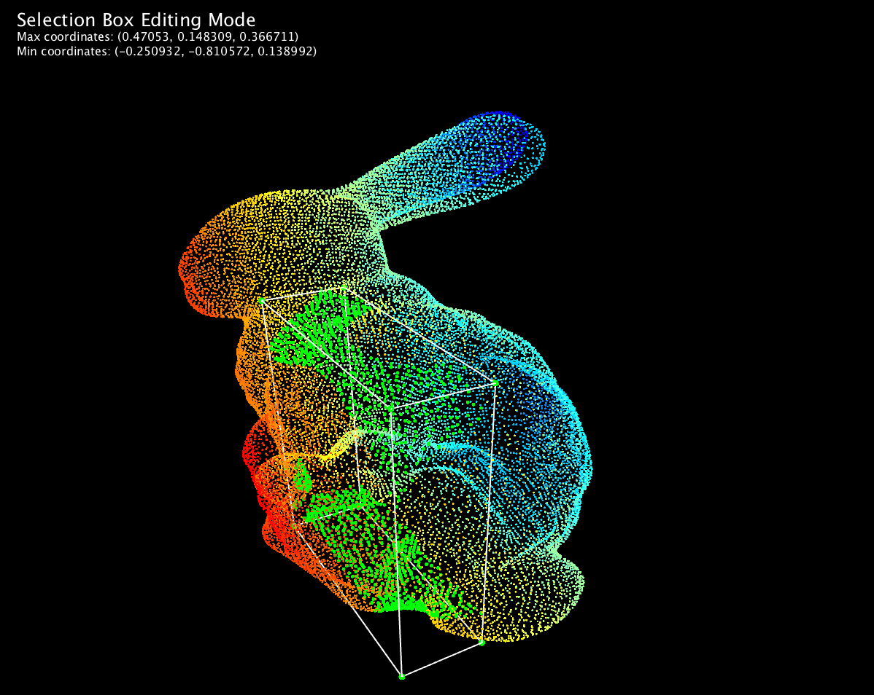
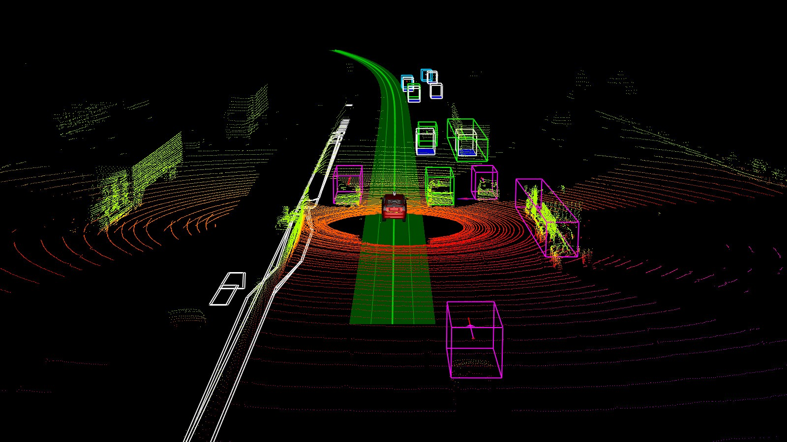
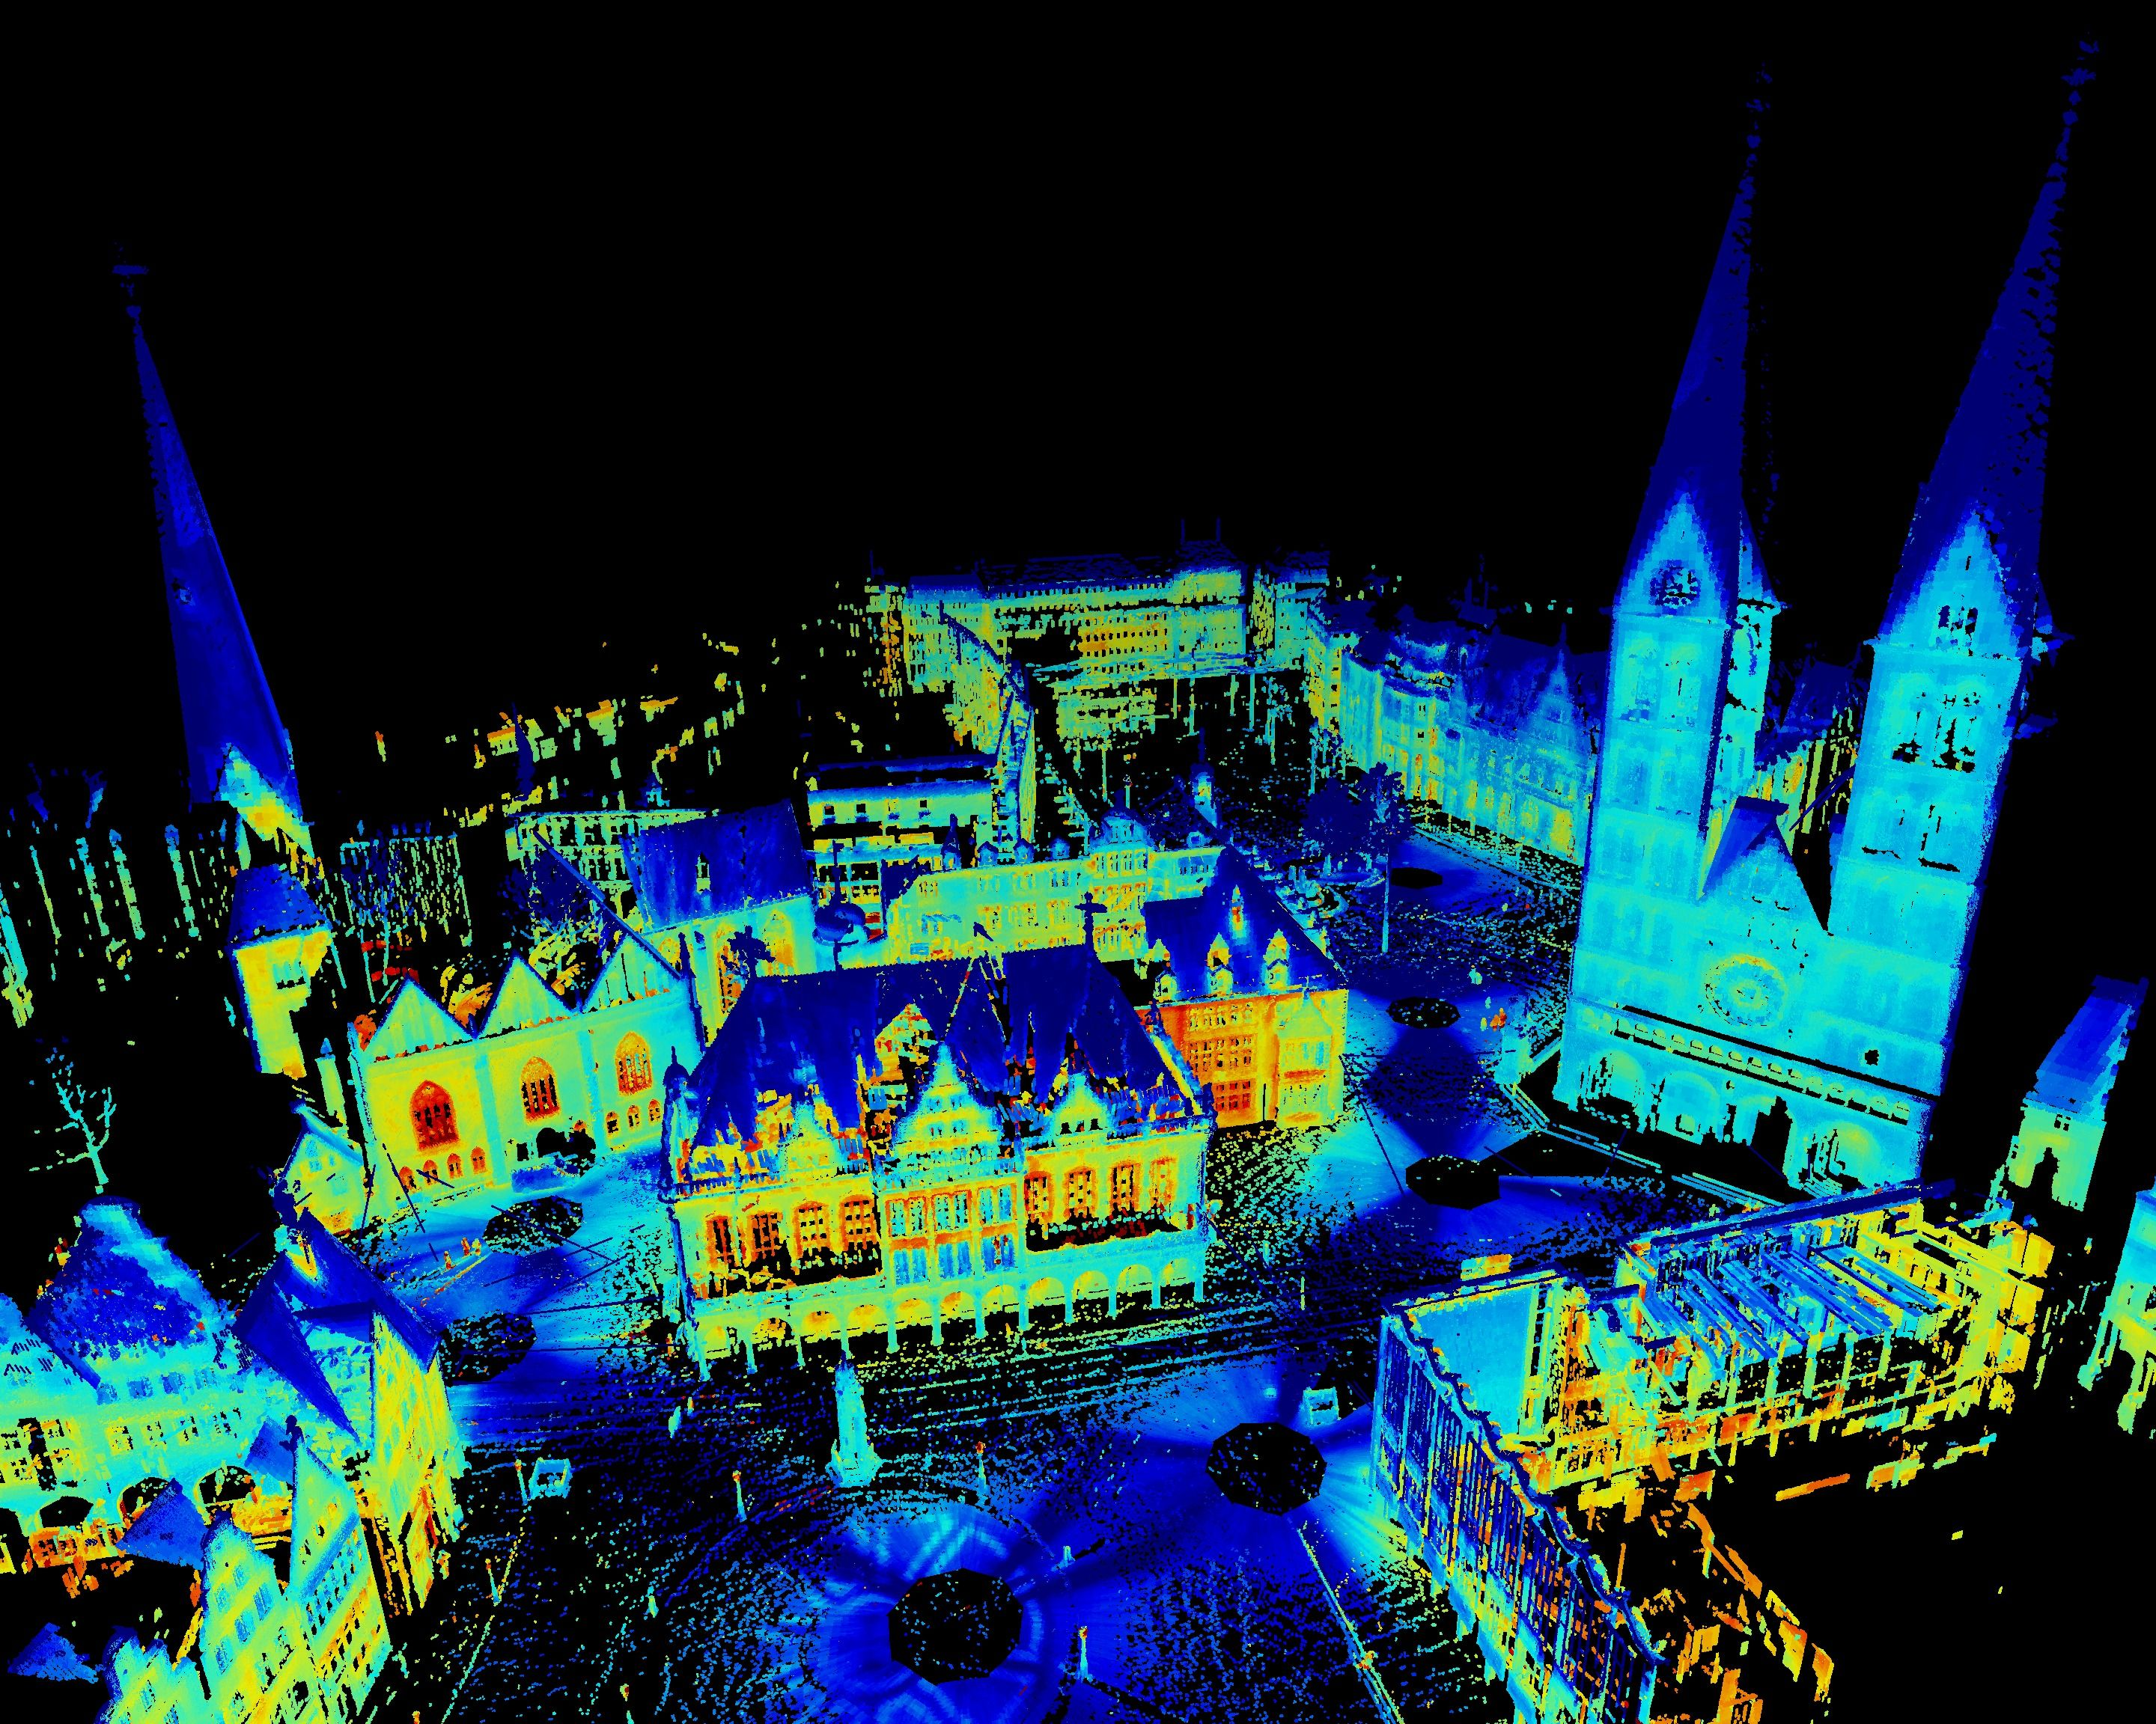
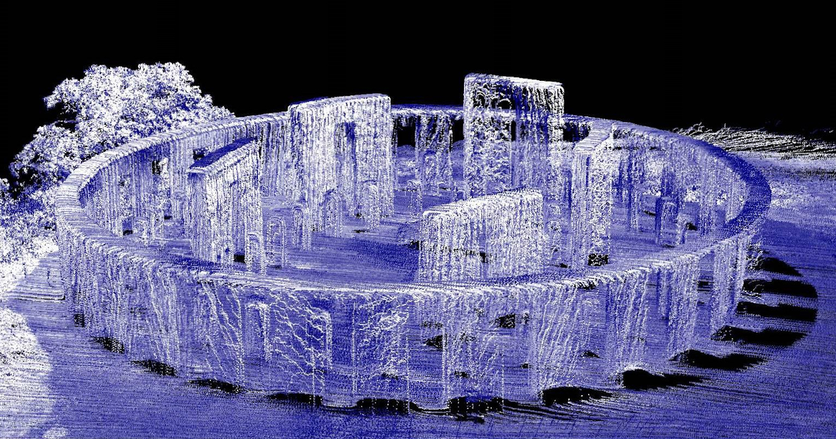
The computer recognizes the point cloud dataset

Slide 8
PROBLEM STATEMENT

Slide 9
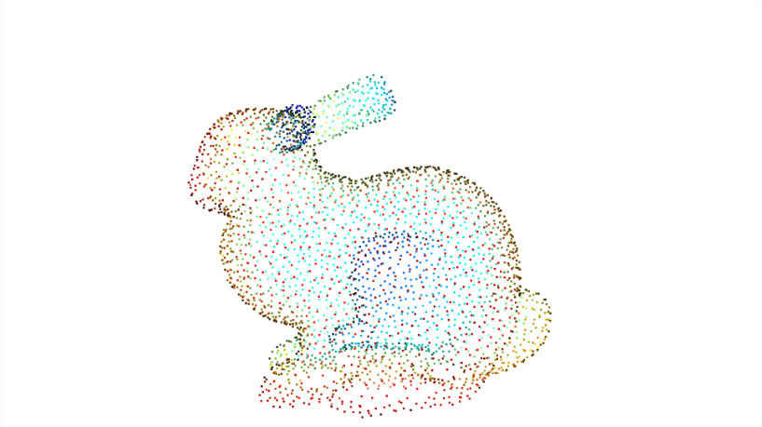
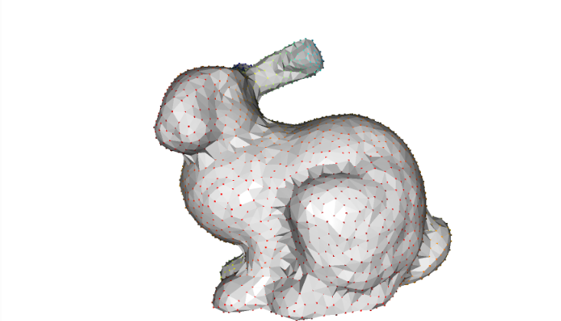
Problem Statement
Input
Output
Input
Point Cloud Segmentationon
Polygonization
Output

Slide 10
INTRODUCE TO PCL

Slide 11

An open-source library of algorithms for point cloud processing tasks and 3D geometry processing.
Written C++.
Supports MacOS, Windows, Linux and Android.

Slide 12
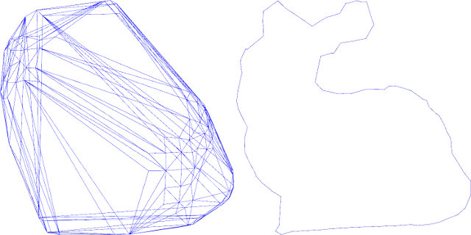
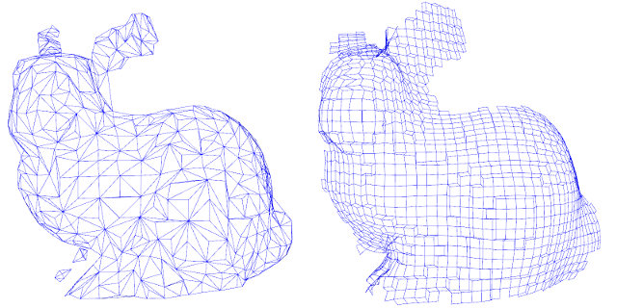
Module Surface
The pcl_surface library deals with reconstructing the original surfaces from 3D scans.
Smoothing and resampling can be important if the cloud is noisy, or if it is composed of multiple scans that are not aligned perfectly.
Meshing is a general way to create a surface out of points.
Creating a convex or concave hull is useful.

Slide 13
MARCHING CUBE

Slide 14
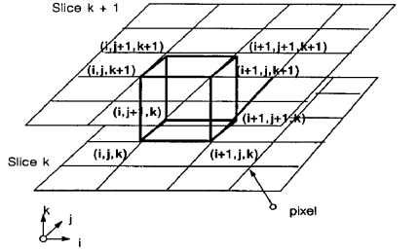
Marching Cube
Marching cubes uses a divide-and-conquer approach to locate the surface in a logical cube created from eight pixels; four each from two adjacent slices.

Slide 15
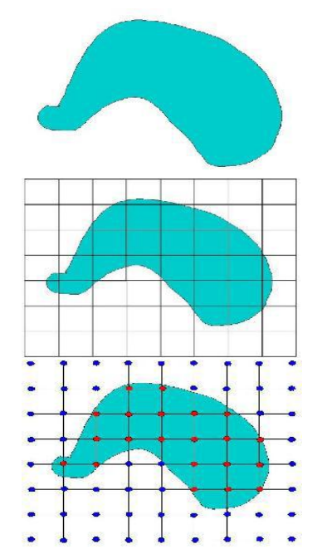
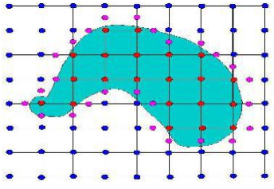
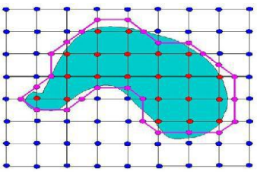
Marching Cube
Step 1: Image Object
Step 5: Find Offset Points
Step 2: Segmented Image
Step 7: Joint all Offset points
Step 3: Intersected Point Finding

Slide 16
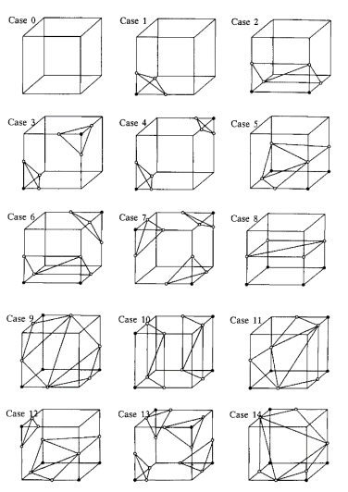
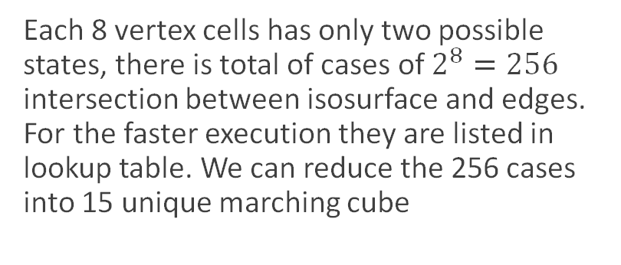
Marching Cube
Each 8 vertex cells has only two possible states, there is total of cases of $2^{8}=256$ intersection between isosurface and edges. For the faster execution they are listed in lookup table. We can reduce the 256 cases into 15 unique marching cube

Slide 17
Marching Cube

Slide 18
References
[1] Dirk Holz, Alexandru E. Ichim, Federico Tombari, Radu B. Rusu, and Sven Behnke, “Registration with the Point Cloud Library A Modular Framework for Aligning in 3-D”, 2015
[2] Werner Purgathofer, Markus Vincze, “Reconstruction of 3D Models from Images and Point Clouds with Shape Primitives”, 2013
[3] Radu Bogdan Rusu and Steve Cousins Willow Garage, “3D is here: Point Cloud Library (PCL)”
[4] Laurent Caraffa, Yanis Marchand, Mathieu Brédif, Bruno Vallet, “Efficiently Distributed Watertight Surface Reconstruction”, 2021
[5] Marcos Vinicius Mussel Cirne, Hélio Pedrin, “Marching Cubes Technique for Volumetric Visualization. Accelerated with Graphics Processing Unit”, 2013 [6] William E. Lorensen, Harvey E. Cline, “Marching Cubes: A High Resolution 3D Surface Construction Algorithm”, 1987

Slide 19
Thank you

